Slide 1
Essentials of Turbulence : Vortex Shedding Past Square Cylinder
Sanit Bhatkar 173109003

Slide 2
Problem Description
Vortex Shedding is an oscillating flow that takes place when a fluid flows past a bluff body in certain range Re.
Vortices are created at the back of the body and detach periodically from either side of the body.
Strouhal Number
Lyn [1] performed Laser-Doppler
Velocimetry for one period of vortex.
Vortex shedding past cylinder
Figure is taken from https://en.wikipedia.org/wiki/Vortex_shedding

Slide 3
Objective
Analyse the flow around square cylinder in ANSYS-Fluent and calculate:
Coefficient of discharge Cd
Velocity profile at different longitudinal and lateral
Strouhal number calculation from coefficient of lift Cl
Streamlines for different phases of vortex shedding
Compare Fluent data with Lyin [1] experimental data.

Slide 4
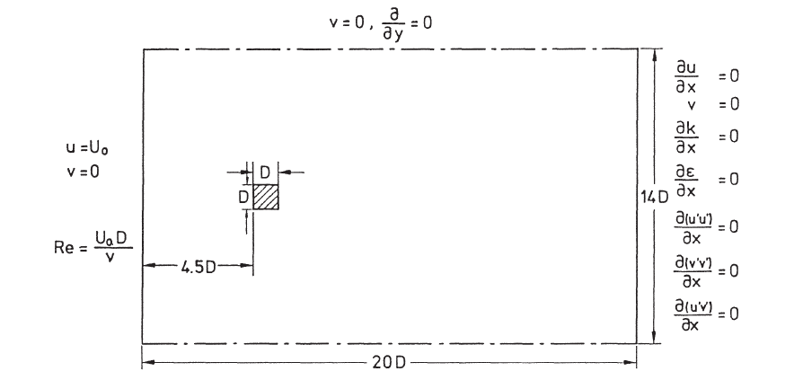
Calculation Domain and BC
Flow Parameters | Value
Reynolds Number | 21400
Free stream turbulence level | 2%
Strouhal number | 0.132
Cylinder diameter | 0.04 m
Working Fluid | Water
Calculation domain and Boundary Conditions
Figure is taken from Franke and Rodi[2]

Slide 5
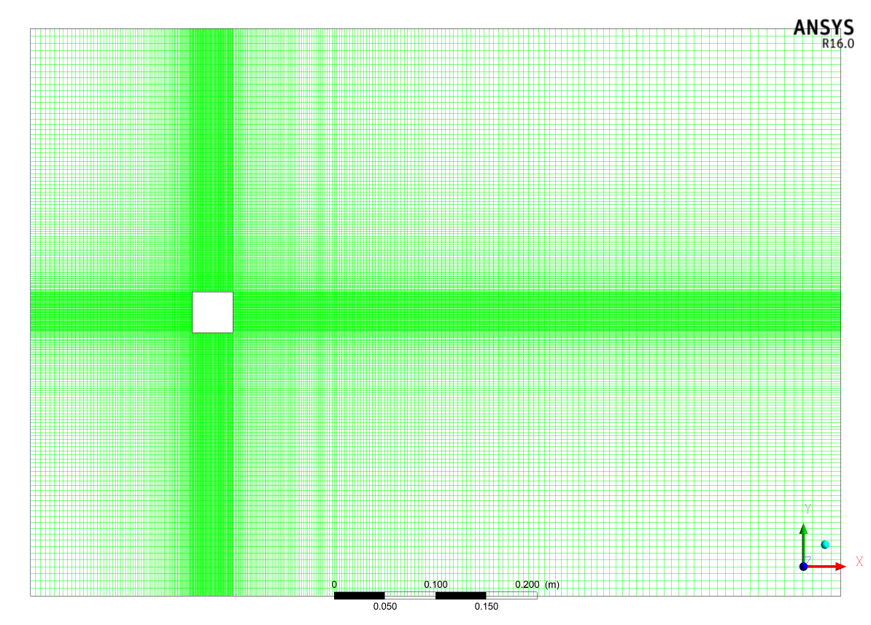
Mesh Details
Notes:
Bias factor 10
Total Nodes 76256

Slide 6
Turbulence Model and Numerical Methods
URANS SST k-ω model [4,5]
SST k-ω model has good behaviour in adverse pressure gradients and separating flow [5]
Numerical Cd matches with experimental value [4]
2D simulation model with FVM and SIMPLE algorithm for governing equations. [3]
Second order implicit scheme for time discretization and third order scheme for spatial discretization.
[3] S. Murakami paper [4] F.Y. Xu paper [5] Ansys Fluent 16 Theory guide
Notes:
Ansys theory manual suggest three ways to simulate vortex shedding in turbulent flows
1. URANS → 1.RSM
2.SST SAS
3.SST k-ω
2. LES
3. DES

Slide 7
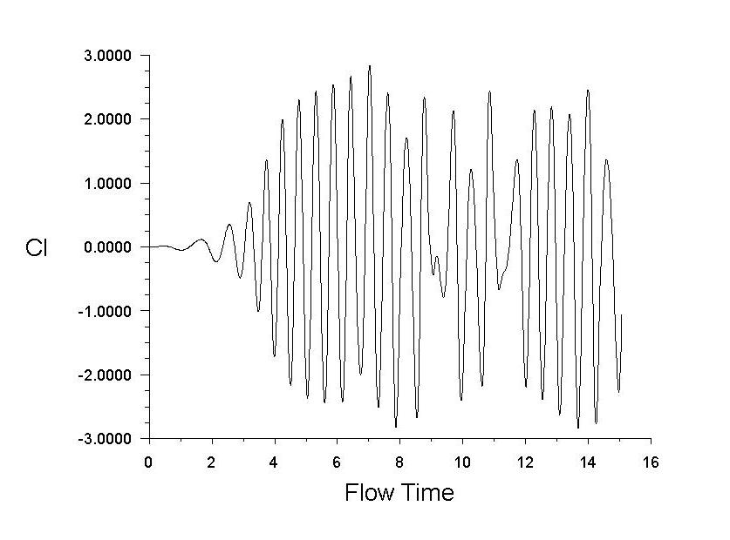
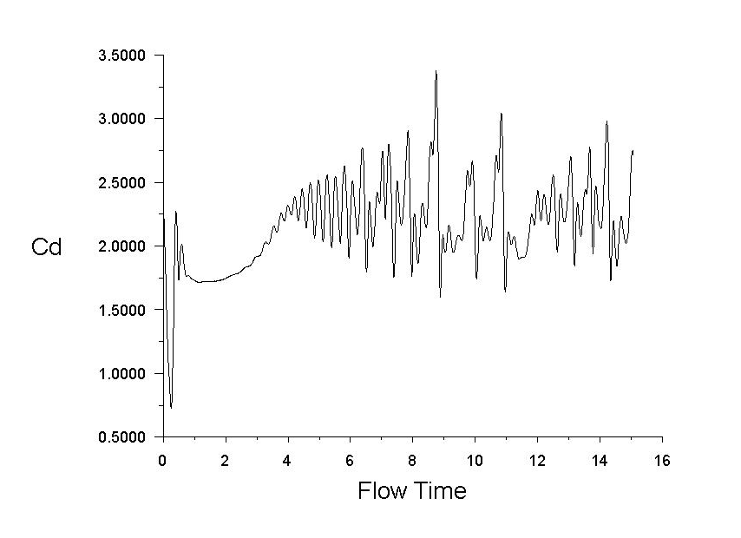
Time step calculation

Slide 8
VALIDATION

Slide 10
Strouhal Number Validation
FFT code Output
---FFT of Lift coefficient---
Strouhal Number is 0.131098
Frequency is 1.761633 Hz
Time period is 0.567655 s
Manual Calculation
Start Time | 4.23 s
End Time | 9.68 s
Total samples | 10
Strouhal Number | 0.137
Frequency | 1.835
Time period | 0.545

Slide 12
Comparison
Flow Parameters | Experiment Value | Numerical Model
Reynolds Number | 21400 | 21400
Free stream turbulence level | 2% | 2%
Strouhal number | 0.132 | 0.131
Drag Coefficient | 2.05-2.23 | 2.14
Working Fluid | Water | Water

Slide 13
RESULTS

Slide 14
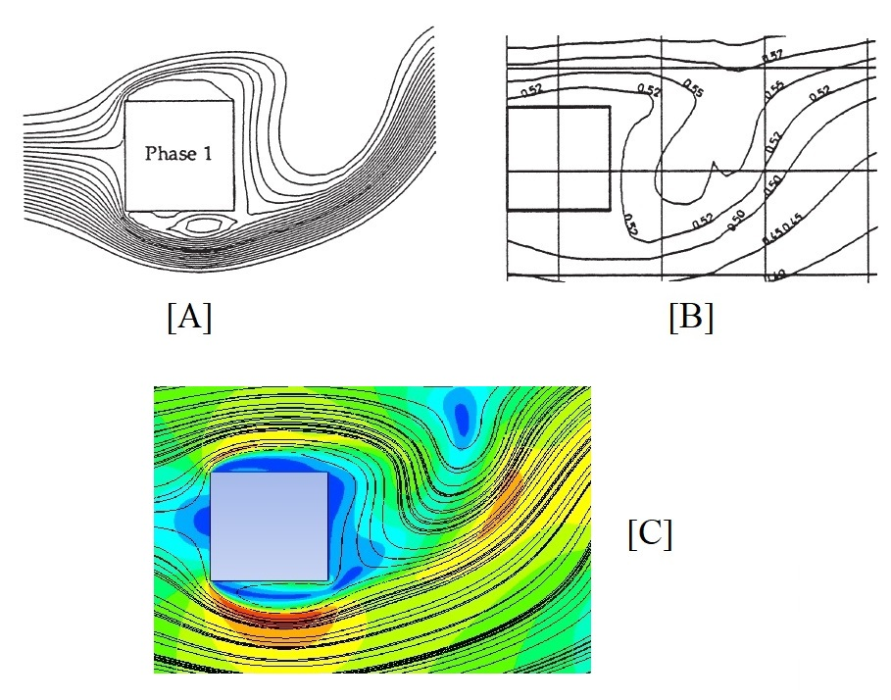
Streamline Plot for phase 1
[A] Franke and Rodi[2]
[B] Lyin [1]
[C] Present numerical
calculation

Slide 15
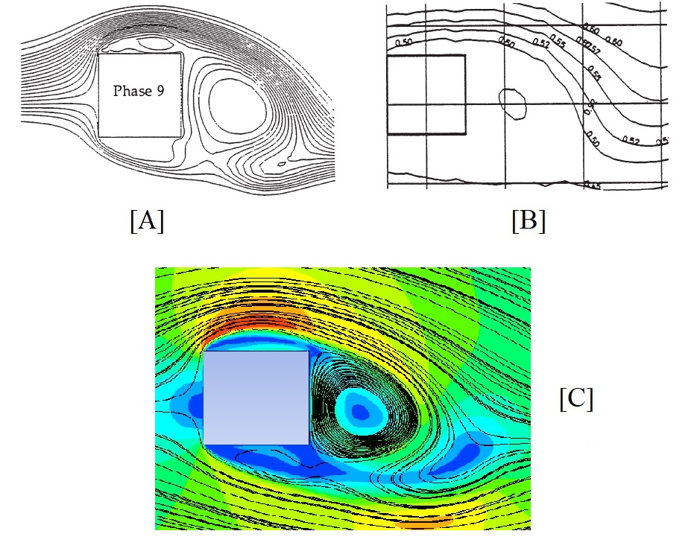
Streamline Plot for phase 9
[A] Franke and Rodi[2]
[B] Lyin [1]
[C] Present numerical
calculation

Slide 22
Sources of Error and Conclusion
Time step was approximated as 0.56s and divided into 20 phases for simplicity
Time step size can have effect on the results as St = 0.131 for present case while St = 0.121 for Xu et al [4].
By and large the SST k-ω model predicts the vortex shedding behaviour. Velocity is overestimated by the model.
One can create 3D square cylinder to check the accuracy of the model.

Slide 23
References
[1] J.H.P. D.A. Lyin., S.Einav., W.Rodi., “A laser-Doppler velocimetry study of ensemble-averaged characteristics of the turbulent near wake of a square cylinder,” J. Fluid Mech. 304 (1995) 285–319. doi:10.1017/S0022112095004435
[2] R. Franke, W. Rodi, “Calculation of Vortex Shedding Past a Square Cylinder with Various Turbulence Models,” Turbul. Shear Flows 8. (2011) 189–204. doi:10.1007/978-3-642-77674-8_14
[3] S. Murakami, A. Mochida, “On turbulent vortex shedding flow past 2D square cylinder predicted by CFD,” J. Wind Eng. Ind. Aerodyn. 54–55 (1995) 191–211. doi:10.1016/0167-6105(94)00043-D
[4] F.Y. Xu, X.Y. Ying, Z. Zhang, “Prediction of Unsteady Flow around a Square Cylinder Using RANS,” Appl. Mech. Mater. 52–54 (2011) 1165–1170. doi:10.4028/www.scientific.net/amm.52-54.1165
[5] FLUENT, Inc., ANSYS FLUENT 16.0 Theory Guide, 2015.

